Slide 1
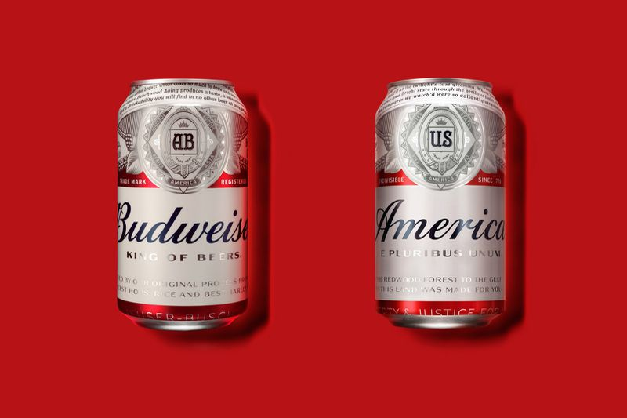
DS6306 Case Study 01 EDA
Adam Canton & Carl Keusseyan

Slide 2
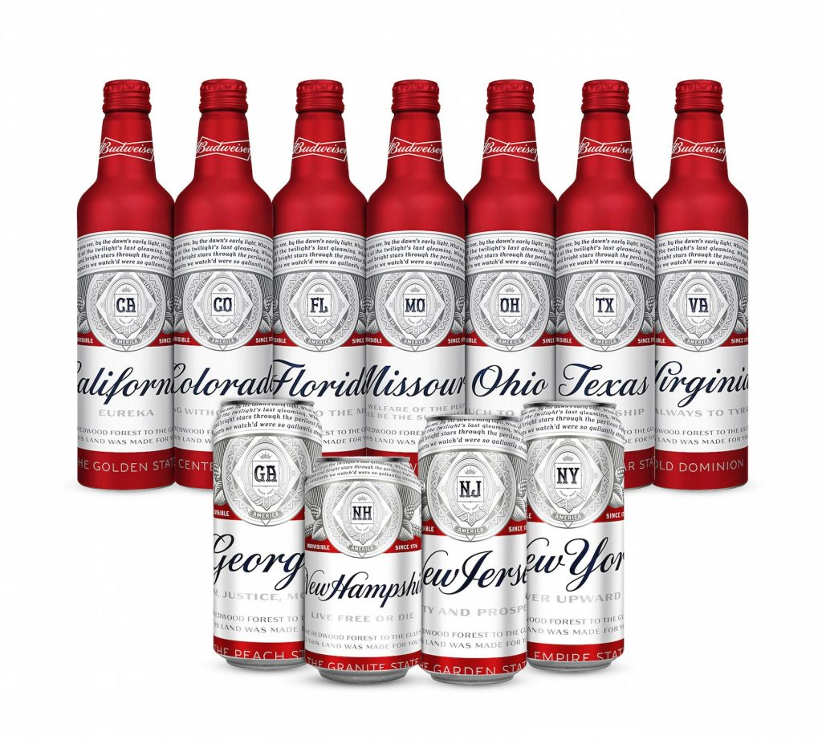

Background
The C & K Consultants are honored to present an insight on Beer Styles and Breweries to the CEO & CFO of Budweiser, with a final recommendation of new product development and deployment.

Slide 3
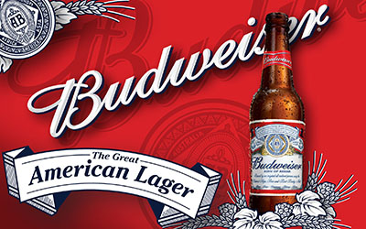
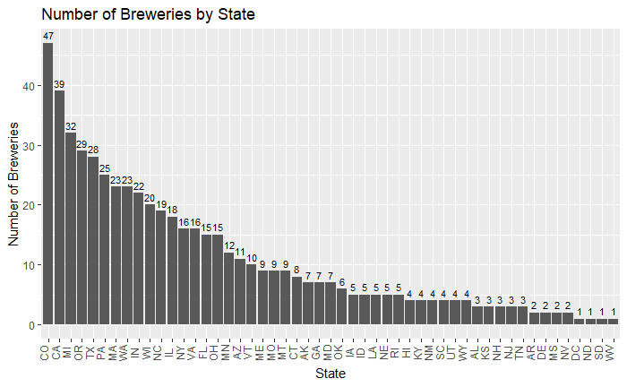
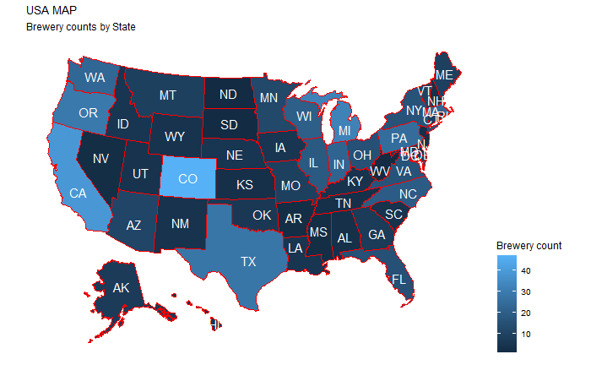
How many breweries are present in each state?
We take note that Colorado, California and Michigan have the most breweries
While West Virginia, North and South Dakota, as well as DC have the least breweries

Slide 4

Anytime you deal with a dataset you must consider missing data (no such thing as perfect data)
Noticed the following missing values on the original dataset
62 beers did not have ABV values
1005 beers did not have IBU values
After our research we were able to get the missing values down to
17 beers did not have ABV values
998 beers did not have IBU values
Fortunately C & K Consultants are never swayed by missing data – especially if they can find a relationship between variables and predict with a certain level of certainty, the missing values.

Slide 5
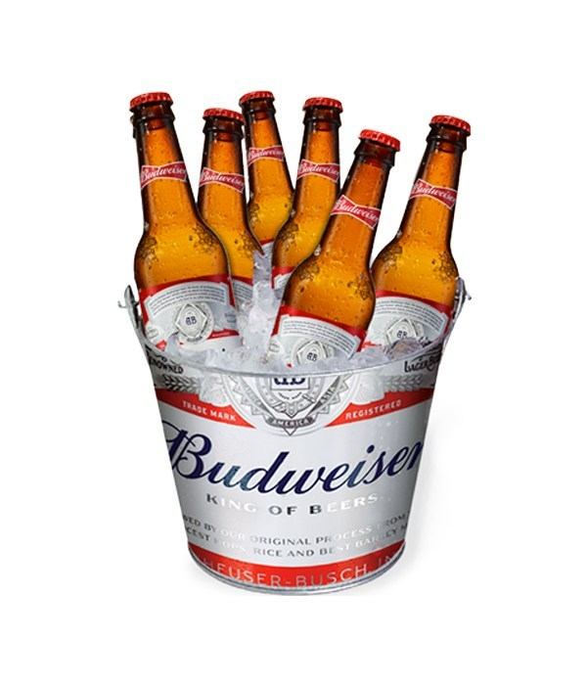

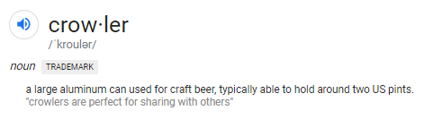
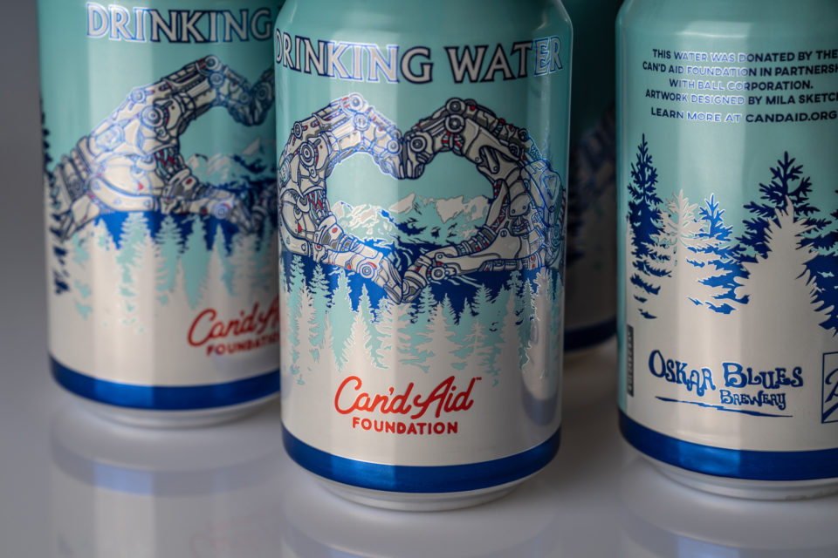
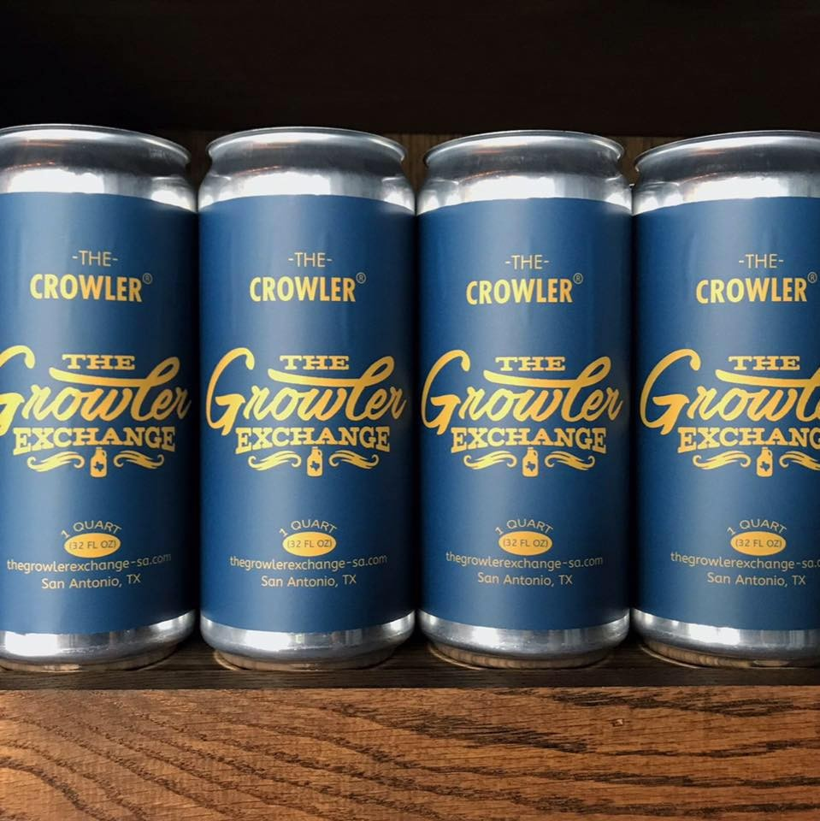
Dealing with missing ABV Values
Dropped the 17 ABV beers, since
some of the beers no longer exist,
no longer produced and
not even beers

Slide 6
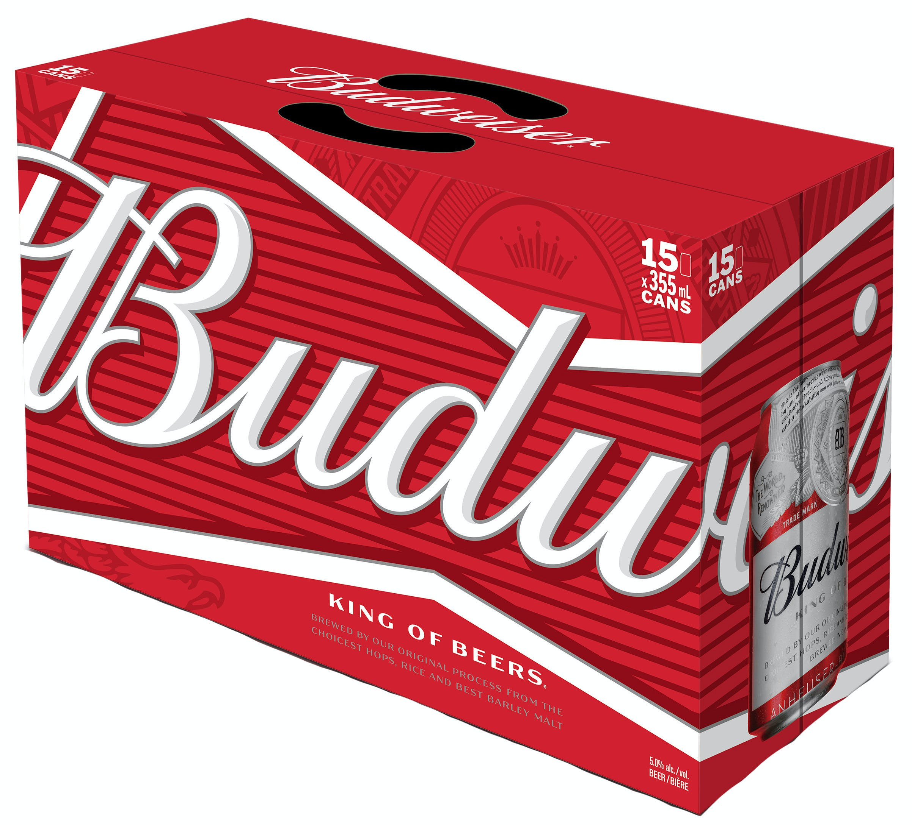
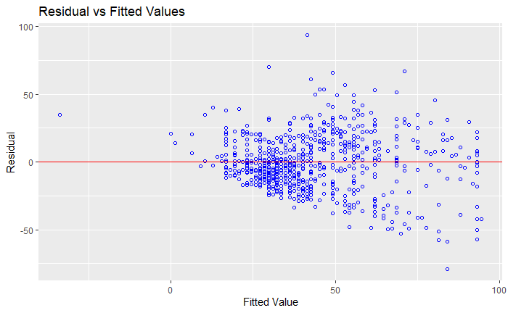
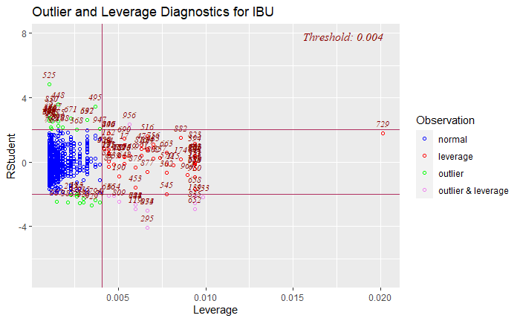
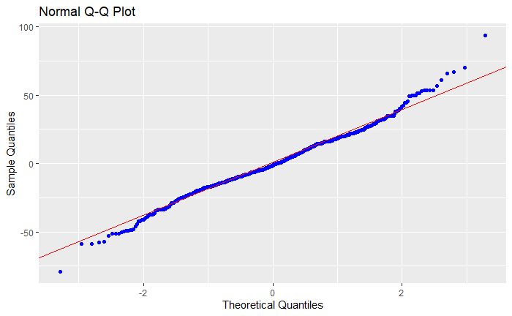
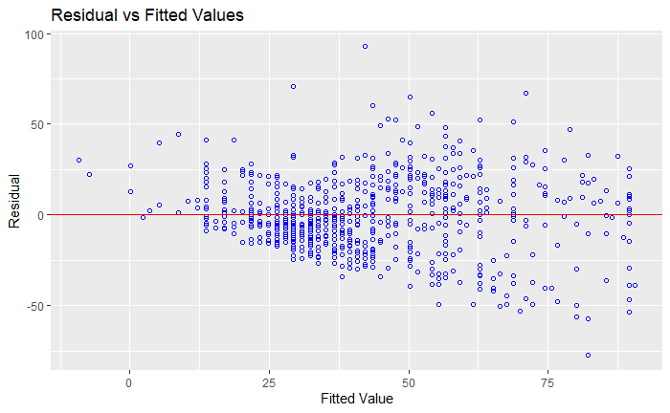
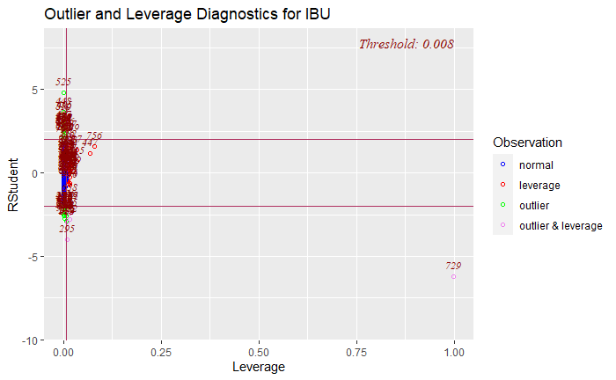

Dealing with the missing IBU values
We found linear relationship b/w IBU and ABV after running several models
Model 1
Model 2

Slide 7
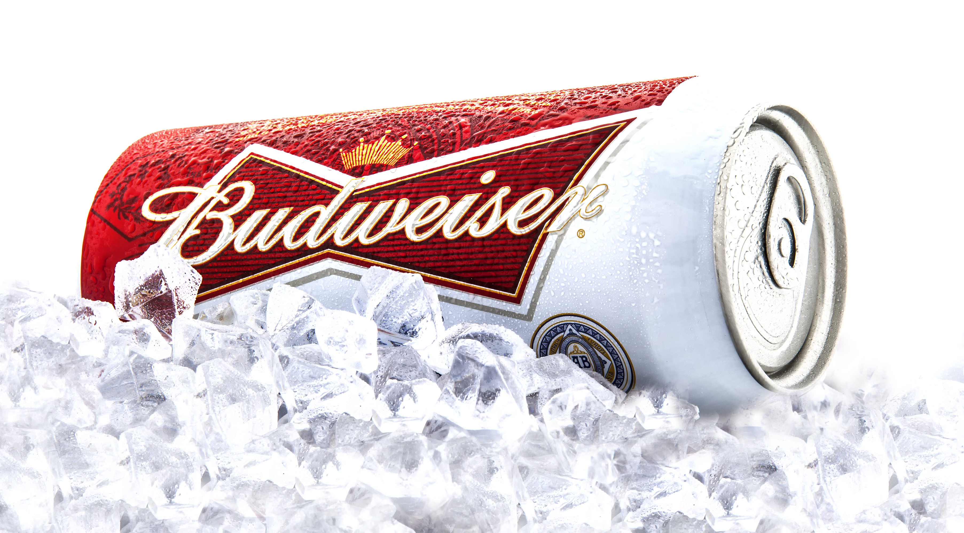
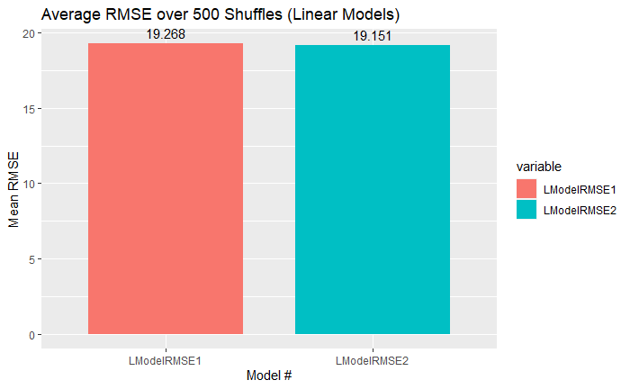
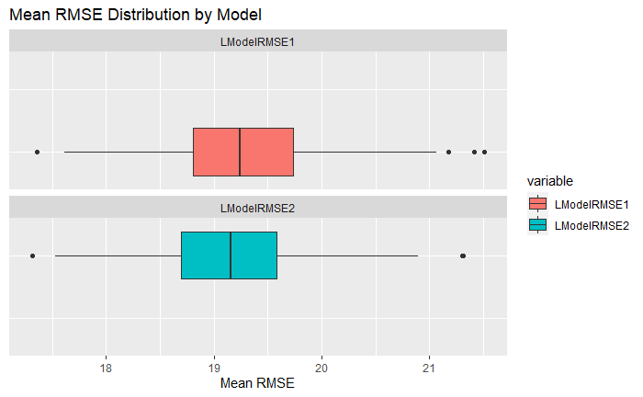
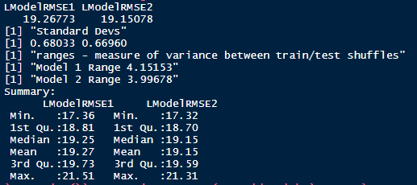
Dealing with the missing IBU values
Benchmarked the models to find the best Linear Model
RMSE (Root Mean Squared Error) is least on Model 2
Model 2 WINS !!

Slide 8
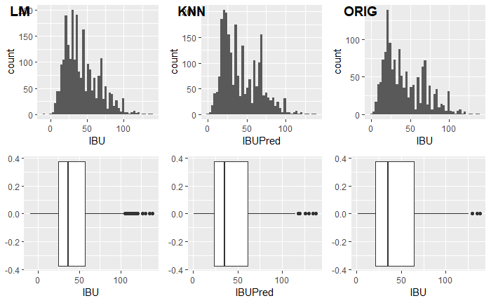
Dealing with the missing IBU values
To ensure that we have exhausted other methodologies of prediction and derived the best prediction we also explored the KNN method
Imputing the values and comparing the models to the Original

Slide 9
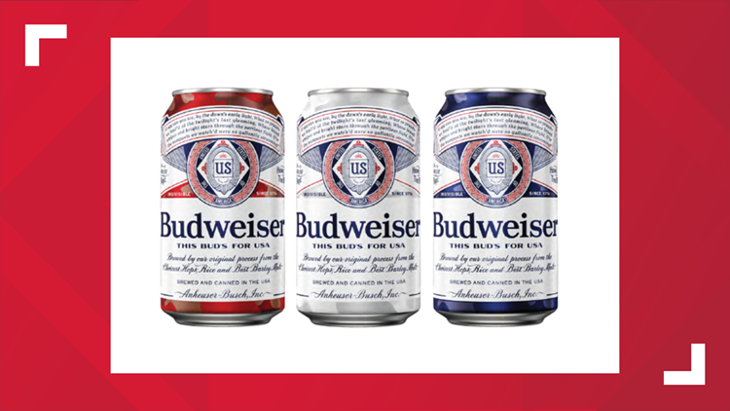
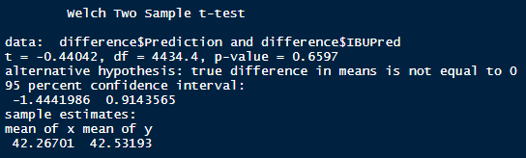
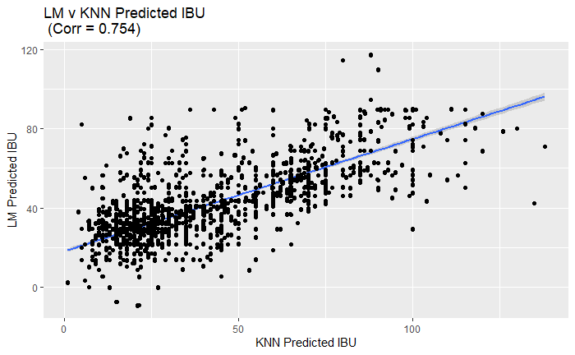
Dealing with the missing IBU values
Evaluating which model by comparing LM and KNN
Ran Welch Two Sample T-Test p_value > α models are alike
We can see visually that the values track with a 75% correlation
Being so close, we chose KNN
due to the odd fit statistics of
the Linear Models

Slide 10
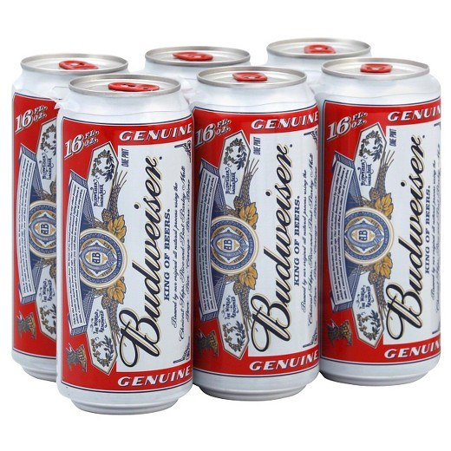
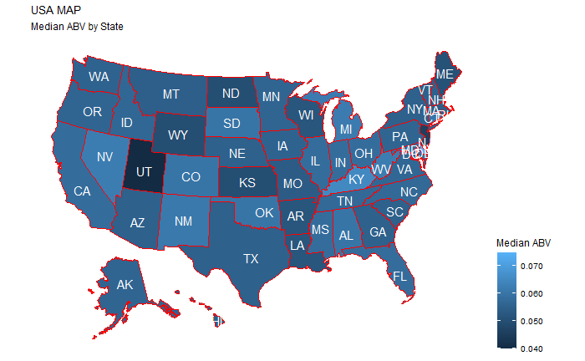
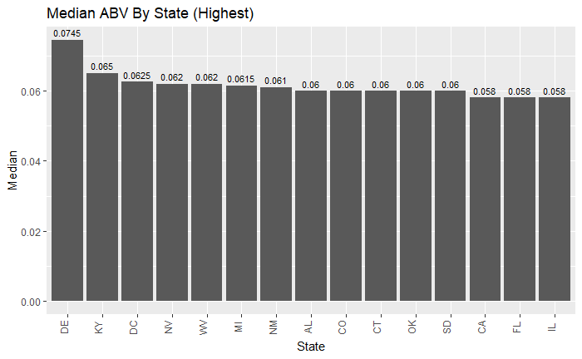
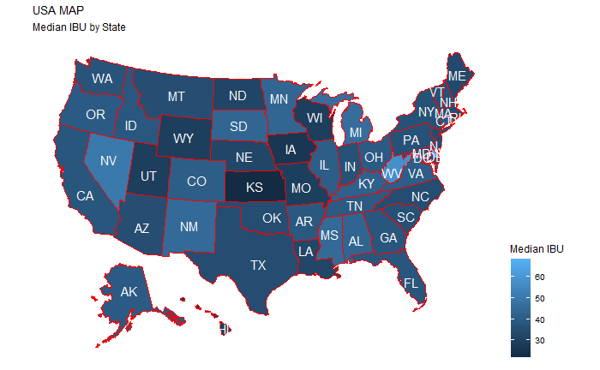
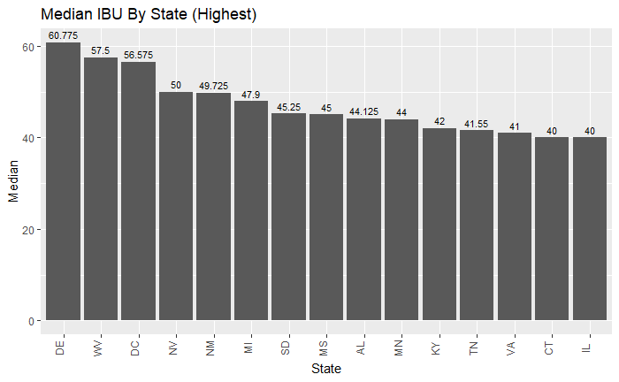
ABV and IBU for each state.
ABV
MAX ABV is Colorado
Value: 12.8 %
IBU
MAX IBU is Oregon
Value: 138

Slide 11
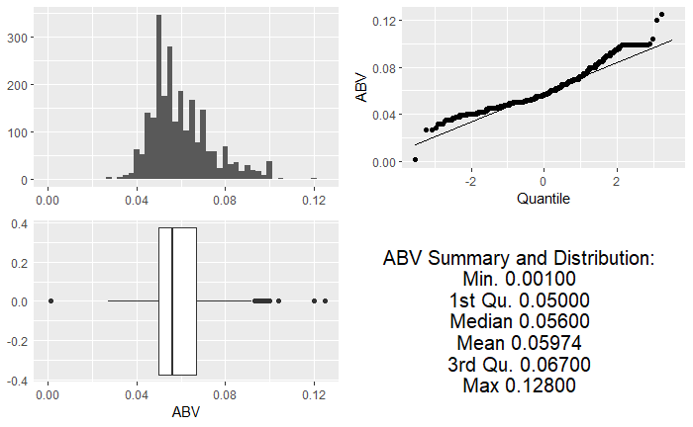
Summary statistics and distribution of the ABV variable.

Slide 12
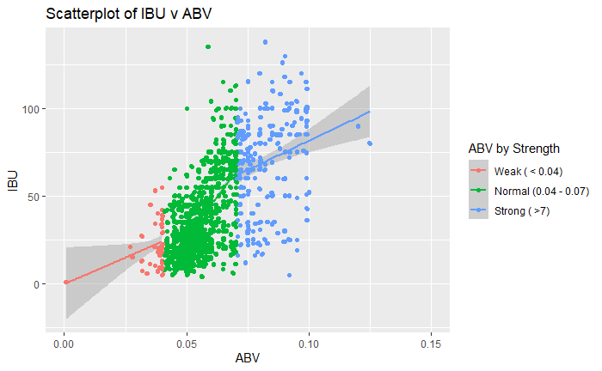


Relationship between the bitterness of the beer and its alcoholic content
There is a relationship between ABV and IBU –
In general the higher the alcohol content the more bitter the beer

